Slide 1

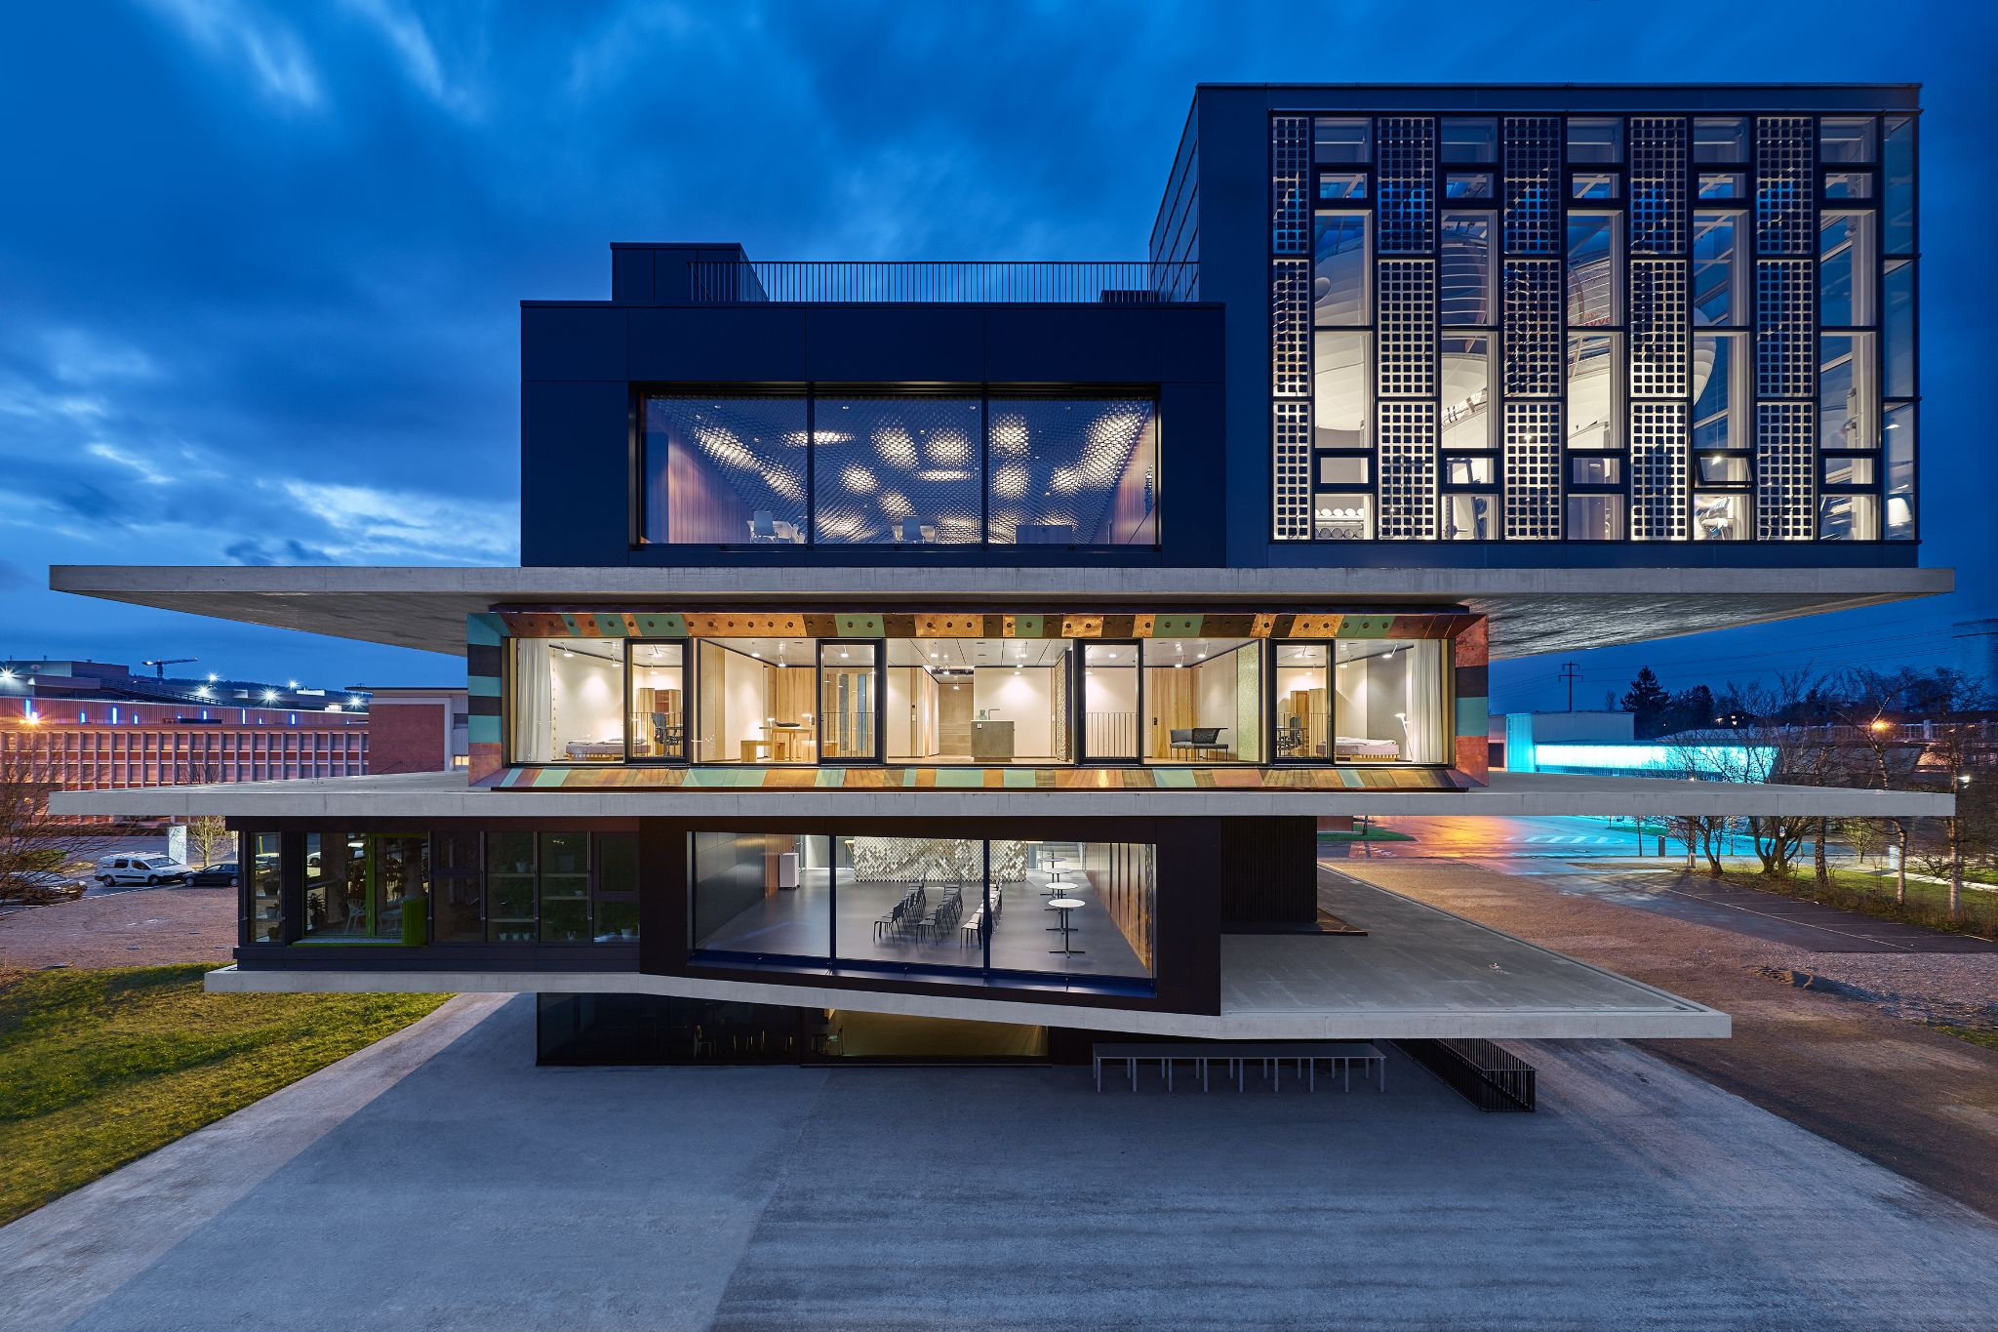
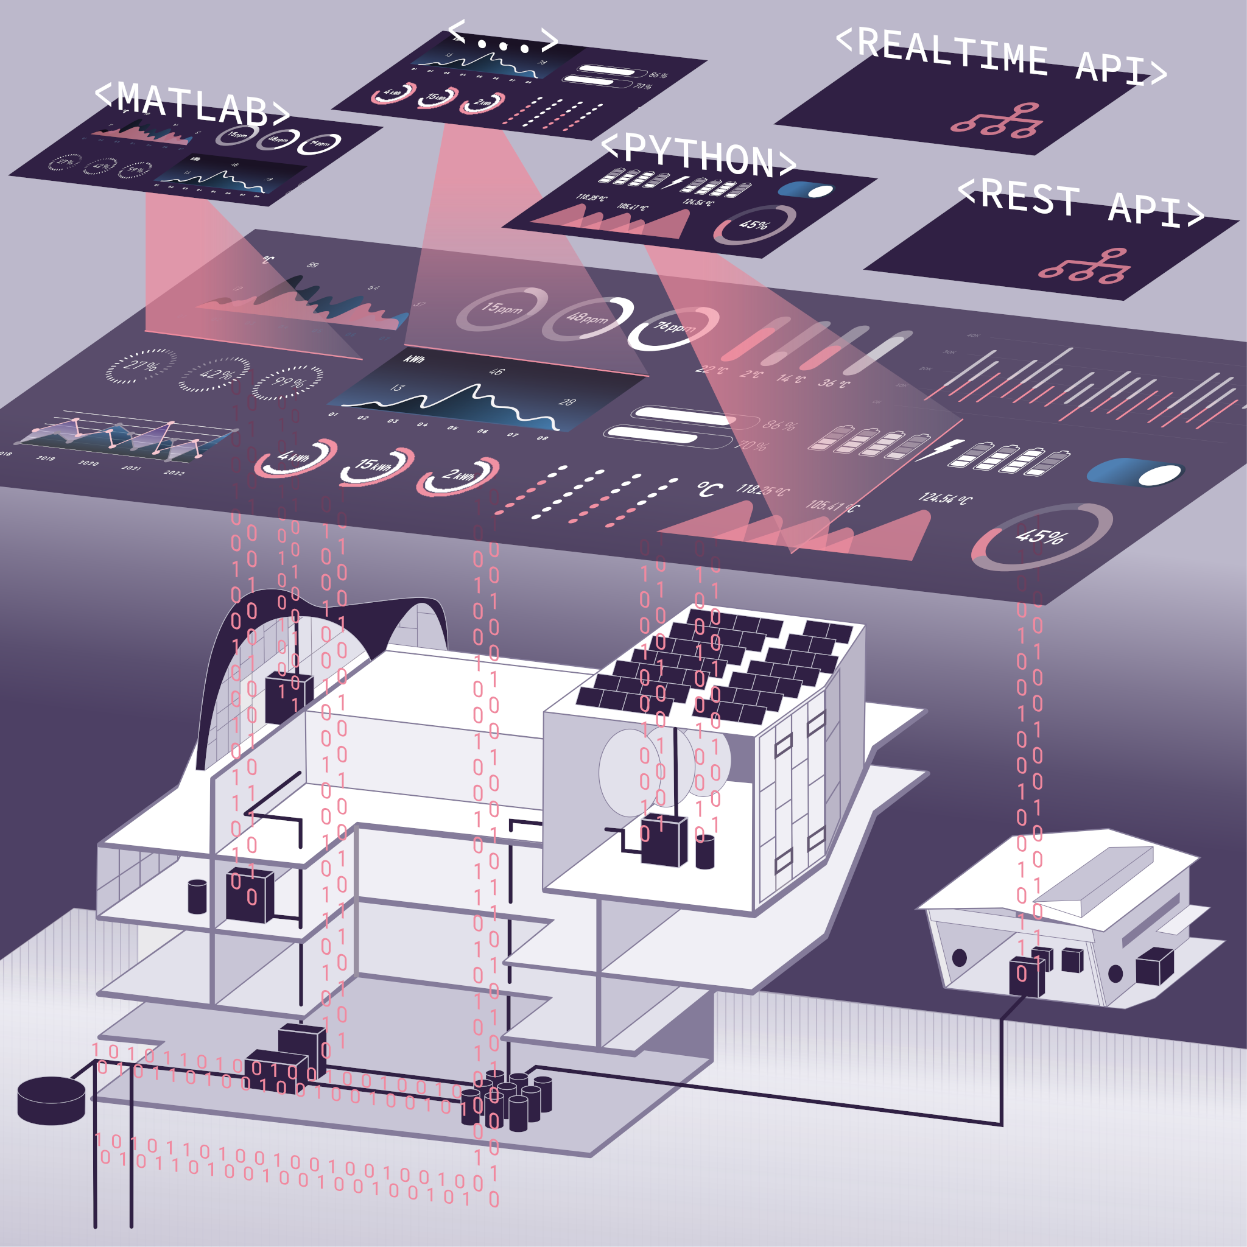
Project Nr 4
NEST, a Data-driven Building Model
4
Team:Robert Hop, Marella Pop, Al Whoop

Slide 2
Vertical Farming
General Model for SolAce
Heat energy at t+1 is Heat energy at t plus Heat increase minus Heat decrease
Heat increase
Space heating delivered to the unit
Radiation shining through the windows
Heat generated by people present in the room
Heat decrease
Heat transfer through the walls
Space cooling delivered to the unit
4

Slide 3
Vertical Farming
General Model for SolAce
Dependent variable
Change of Heat energy represented by change of Room temperature (= average of temp_room)
Independent variables
Space heating (= heating_power)
Radiation heat represented by (= rad_room)
People heat represented by Presence (= praes_room)
Heat transfer represented by Temperature difference (= temp_diff)
Space cooling (= cooling_power)
4

Slide 4
Vertical Farming
General Model for SolAce
Calculated measurement variables
temp_room = average of temp_meeting and temp_office
rad_room = irrad * (blinds_height_F1 + blinds_height_F2 + blinds_height_F3 + blinds_height_F4) during 11am and 5pm and 0 outside of these hours
praes_room = maximum of praes_meeting and praes_office
temp_diff = temp_amb - temp_room
4

Slide 5
Vertical Farming
General Model for SolAce
Calculated time variables
day_of_week = 0 for Monday to 6 for Sunday
is_weekend = true for Saturday and Sunday
hour = hour of time variable
4

Slide 6
Vertical Farming
The Challenge
Dezentralisierung: Zurück ins Quartier?
Halböffentliche Mini Containers bieten vielleicht mehr Kontrolle?
Hotline bei Funktionsstörungen oder bei Littering?
The Idea
Geschichten und Infos vor Ort für Kinder und Erwachsene zu Themen wie Kreislaufwirtschaft, Umweltbewusstsein und Bastelanleitungen für Upcycling.
Entsorgung als Erlebnis gestalten?
4

Slide 7
Vertical Farming
What we did
Dezentralisierung
Halböffentliche Mini Containers bieten mehr Kontrolle
Hotline bei Funktionsstörungen.
Meldung via IoT-Sensoren
Prototype
4

Slide 8
Vertical Farming
Ressources / Data
Dezentralisierung: Zurück ins Quartier?
Halböffentliche Containers bieten vielleicht mehr Kontrolle?
Hotline bei Funktionsstörungen?
Meldung über Füllstand, evtl. via IoT-Sensoren?
Next steps
4
Team: Al Whoop, Robert Hop, Marella Pop

